Slide 1
Introduction to Machine Learning. Basic Concepts and Learning Paradigms.
Radu Ionescu, Prof. PhD.
raducu.ionescu@gmail.com
Faculty of Mathematics and Computer Science
University of Bucharest

Slide 2
Machine Learning
Artificial Intelligence
Natural Language
Processing
Machine
Learning
Kernel Methods
Deep Learning
Nearest Neighbors
Knowledge
Representation
Markov Models
K-means
Expert Systems
Random Forest
Bayesian Models
Hierarchical Clustering
Computer Vision
Image Processing
Signal Processing

Slide 3
Instructors
Lectures:
Radu Ionescu (raducu.Ionescu@gmail.com)
Labs:
Iuliana Georgescu (georgescu_lily@yahoo.com)
Mihail Burduja (warchildmd@gmail.com)

Slide 4
Grading System
Your final grade is composed of:
50% for Project 1
50% for Project 2
Both projects are individual!
Each project consists of comparing two machine learning methods on a specific data set
There are many datasets out there, so no overlap allowed among students!
Project 1 is about comparing two supervised approaches
Project 2 is about comparing two unsupervised approaches
Methods and data sets must be chose beforehand!

Slide 5
Grading System
Project 1 must be presented no later than week 10
Project 2 must be presented no later than the day of the “exam”
There will be no exam!
The average grade of projects 1 and 2 must be >= 5
The project consists of the code implementation in Python (any library is allowed) and a report including:
a description of the dataset
a description of the implemented machine learning methods
figures and/or tables with results
comments on the results
conclusion

Slide 6
Grading System
Extra points during lectures / labs
First to answer a question / solve an exercise gets 0.1 points
Maximum 0.2 points per lecture / lab for each student
Up to 1 point in total

Slide 7
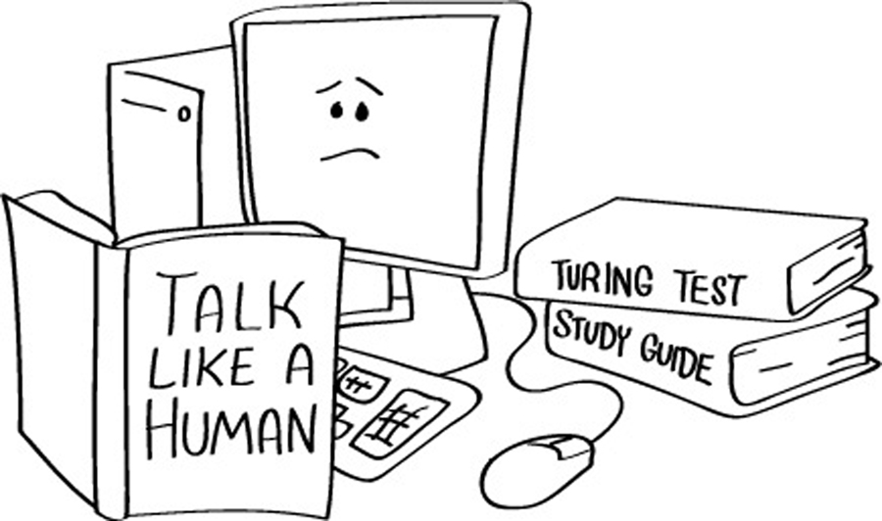
What is artificial intelligence (AI)?
The ultimate goal of artificial intelligence is to build systems able to reach human intelligence levels
Turing test: a computer is said to posses human-level intelligence if a remote human interrogator, within a fixed time frame, cannot distinguish between the computer and a human subject based on their replies to various questions posed by the interrogator

Slide 8
What is machine learning (ML)?
Many AI researchers consider the ultimate goal of AI can be achieved by imitating the way humans learn
Machine Learning – is the scientific study of algorithms and statistical models that computer systems use to learn from observations, without being explicitly programmed
In this context, learning refers to:
recognizing complex patterns in data
making intelligent decisions based on data observations

Slide 9
A well-posed machine learning problem
What problems can be solved* with machine learning?
Well-posed machine learning problem:
"A computer program is said to learn from experience E with respect to some class of tasks T and performance measure P, if its performance at tasks in T, as measured by P, improves with experience E.” – Tom Mitchell
(*) implies a certain degree of accuracy

Slide 10
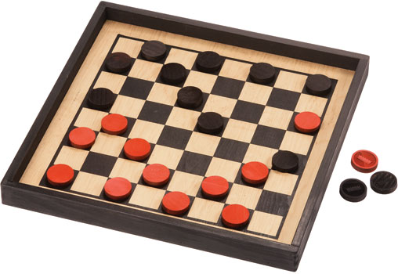
A well-posed machine learning problem
Arthur Samuel (1959) wrote a program for playing checkers (perhaps the first program based on the concept of learning, as defined by Tom Mitchell)
The program played 10K games against itself
The program was designed to find the good and bad positions on the board from the current state, based on the probability of winning or losing
In this example:
E = 10000 games
T = play checkers
P = win or lose

Slide 11
Strong AI versus Weak AI
strong / generic / true AI
(see the Turing test and its extensions)
weak / narrow AI
(focuses on a specific well-posed problem)

Slide 12
When do we use machine learning?
We use ML when it is hard (impossible) to define a set of rules by hand / to write a program based on explicit rules
Examples of tasks that be solved through machine learning:
Face Detection
Speech Recognition
Stock Price Prediction
Object recognition

Slide 13

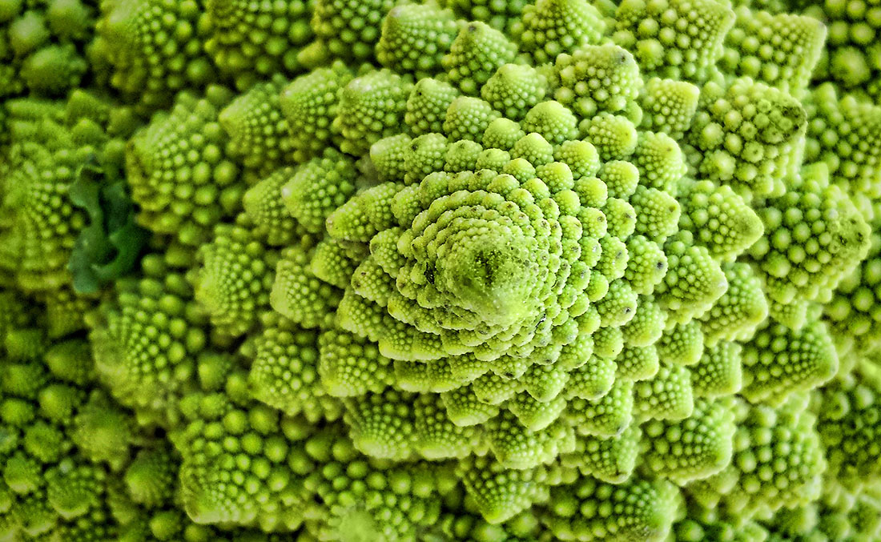
The essence of machine learning
A pattern exists
We cannot express it programmatically
We have data on it

Slide 14
Classic Programming
Data
Computer
Output
Program
Machine Learning
Data
Computer
Program
Output

Slide 15
What is machine learning?
[Arthur Samuel, 1959] field of study that
gives computers the ability to learn without being explicitly programmed
[Kevin Murphy] algorithms that
automatically detect patterns in data
use the uncovered patterns to predict future data or other outcomes of interest
[Tom Mitchell] algorithms that
improve their performance (P)
at some task (T)
with experience (E)

Slide 16
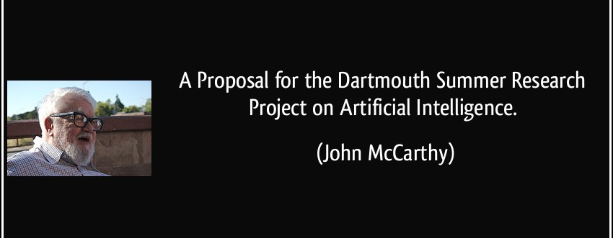
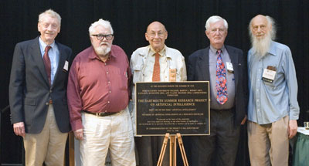
Brief history of AI

Slide 17
Brief history of AI
“We propose that a 2 month, 10 man study of artificial intelligence be carried out during the summer of 1956 at Dartmouth College in Hanover, New Hampshire.”
The study is to proceed on the basis of the conjecture that every aspect of learning or any other feature of intelligence can in principle be so precisely described that a machine can be made to simulate it.
An attempt will be made to find how to make machines use language, form abstractions and concepts, solve kinds of problems now reserved for humans, and improve themselves.
We think that a significant advance can be made in one or more of these problems if a carefully selected group of scientists work on it together for a summer.”

Slide 18
Brief history of AI
1960-1980s: ”AI Winter”
1990s: Neural networks dominate, essentially because of the discovery of the backpropagation for training neural networks with two or more layers
2000s: Kernel methods dominate, essentially because of the instability of training neural networks
2010s: The comeback of neural networks, essentially because of the discovery of deep learning

Slide 19
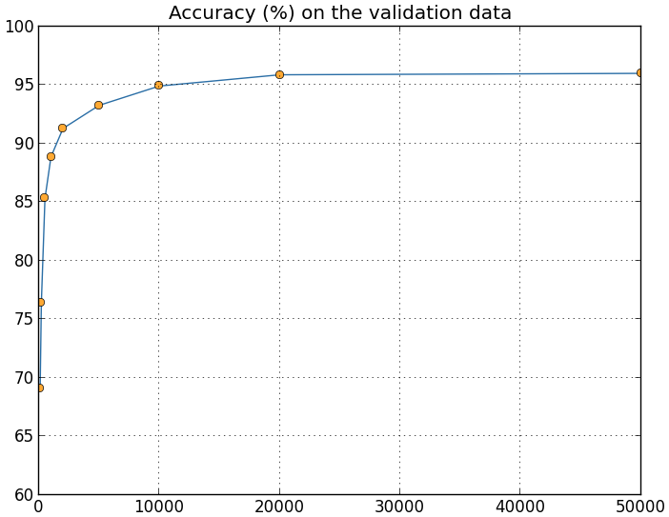
Why are things working today?
More compute power
More data
Better algorithms / models
Accuracy
Amount of Training Data

Slide 20
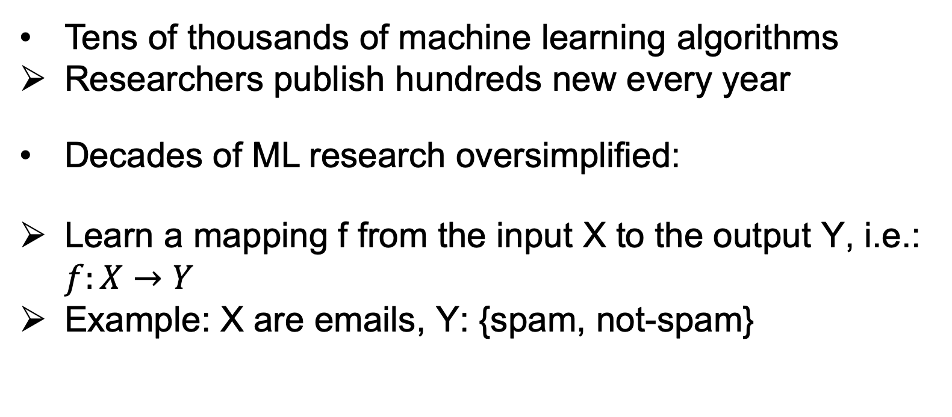
ML in a nutshell
Tens of thousands of machine learning algorithms
Researchers publish hundreds new every year
Decades of ML research oversimplified:
Learn a mapping f from the input X to the output Y, i.e.: $f:X→Y$
Example: X are emails, Y: {spam, not-spam}

Slide 21
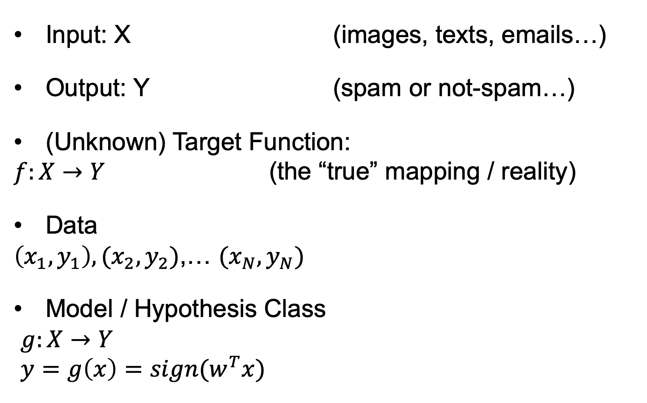
ML in a nutshell
Input: X (images, texts, emails…)
Output: Y (spam or not-spam…)
(Unknown) Target Function:
$f:X→Y$ (the “true” mapping / reality)
Data
$\left(x_{1},y_{1}\right),(x_{2},y_{2})$,… $(x_{N},y_{N})$
Model / Hypothesis Class
$g:X→Y$
$y=g\left(x\right)=sign(w^{T}x)$

Slide 22
ML in a nutshell
Every machine learning algorithm has three components:
Representation / Model Class
Evaluation / Objective Function
Optimization

Slide 23
Where does ML fit in?
Biology
Neuroscience
Applied Maths
Biology of learning
Inspiring paradigms
E.g.: neural networks
Optimization
Linear algebra
Derivatives
E.g.: local minimum
Machine Learning
Computer Science
Statistics
Algorithms
Data structures
Complexity analysis
E.g.: k-d trees
Estimation techniques
Theoretical frameworks
Optimality, efficiency
E.g.: Bayes rule

Slide 24
Learning paradigms
Standard learning paradigms:
Supervised learning
Unsupervised learning
Semi-supervised learning
Reinforcement learning
Non-standard paradigms:
Active learning
Transfer learning
Transductive learning

Slide 25
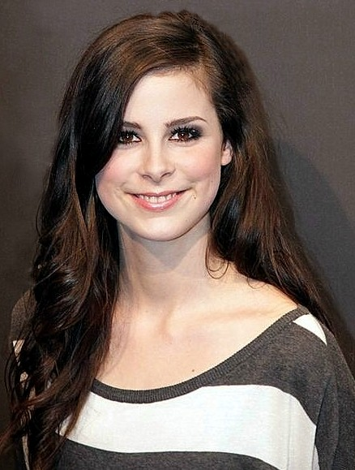
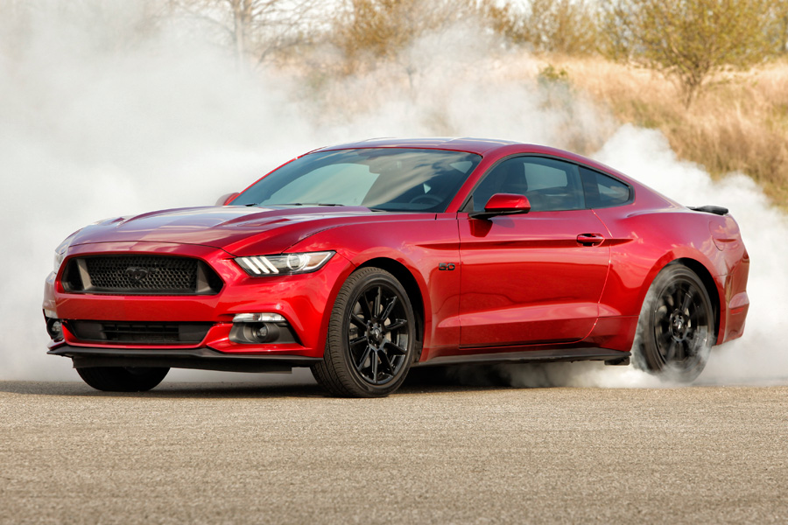

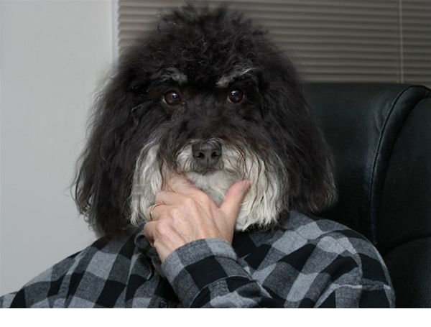
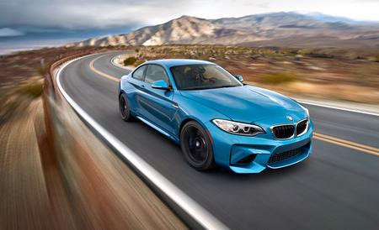
Supervised learning
We have a set of labeled training samples
Example 1: object recognition in images annotated with corresponding class labels
Car
Person
Person
Dog
Car

Slide 26
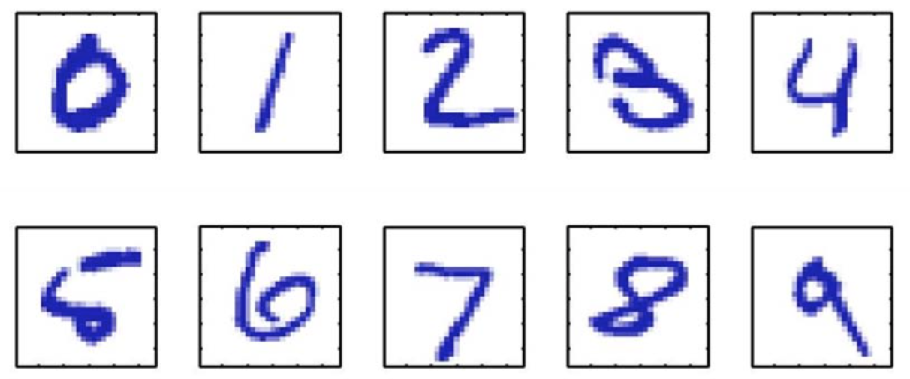
Supervised learning
Example 2: handwritten digit recognition (on the MNIST data set)
Images of 28 x 28 pixels
We can represent each image as a vector x of 784 components
We train a classifier f(x) such that:
f : x → {0, 1, 2, 3, 4, 5, 6, 7, 8, 9}

Slide 27
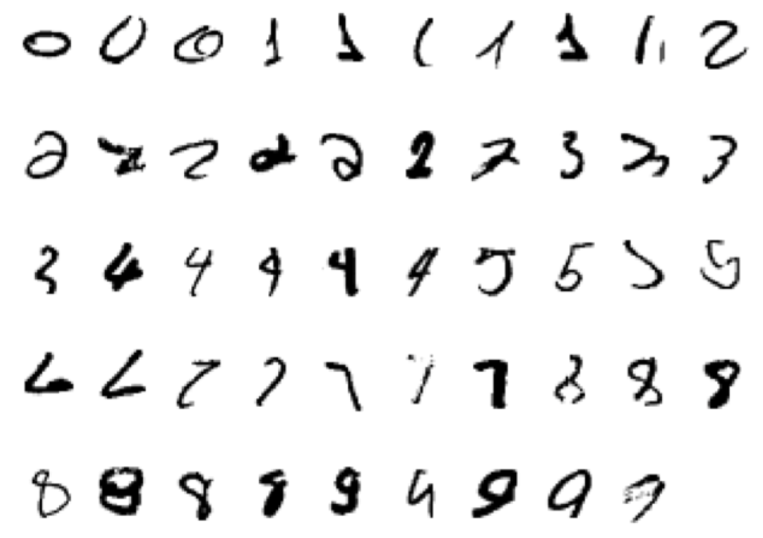
Supervised learning
Example 2 (continued): handwritten digit recognition (on the MNIST data set)
Starting with a training set of about 60K images (about 6000 images per class)
… the error rate can go down to 0.23% (using convolutional neural networks)
Among the first (learning-based) systems used in a large scale commercial setting for postal code and bank cheque processing

Slide 28
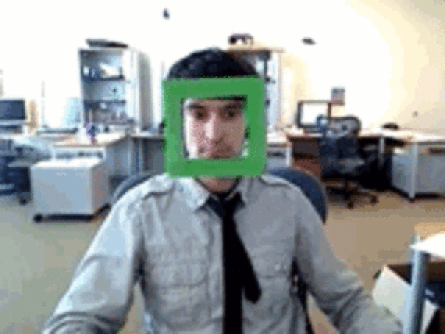
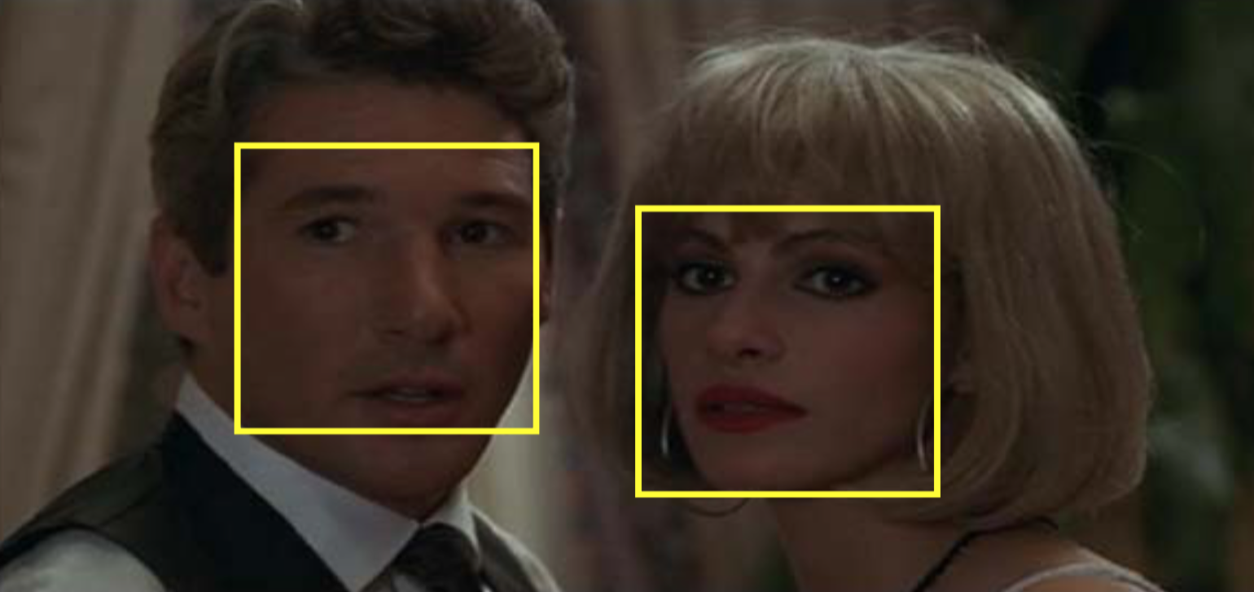
Supervised learning
Example 3: face detection
One approach consists of sliding a window over the image
The goal is to classify each window into one of the two possible classes: face or not-face
The original problem is transformed into a classification problem

Slide 29
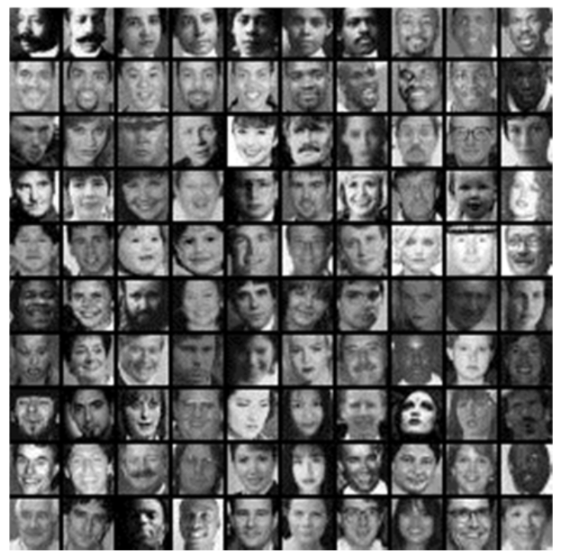
Supervised learning
Example 3: face detection
We start with a set of face images with different variations such as age, gender, illumination, pose, but no translations
… and a larger set of images that do not contain full faces

Slide 30
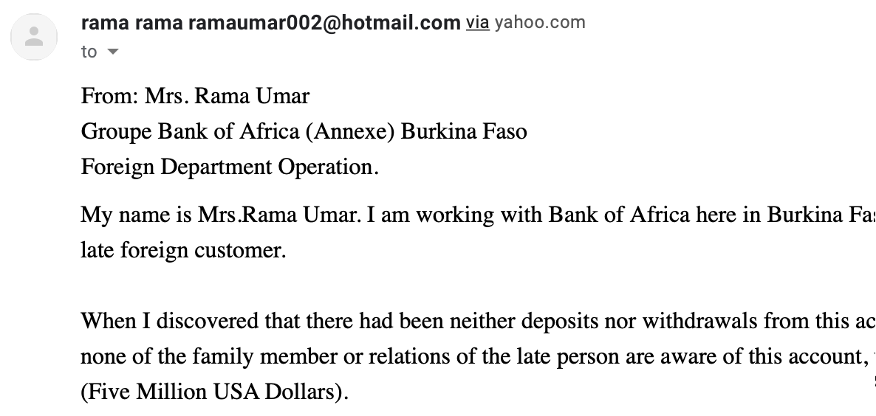
Supervised learning
Example 4: spam detection
The task is to classify an email into spam or not-spam
The occurrence of the word “Dollars” is a good indicator of spam
A possible representation is a vector of word frequencies

Slide 31
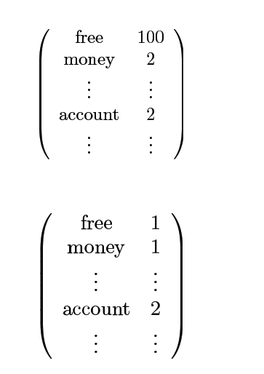
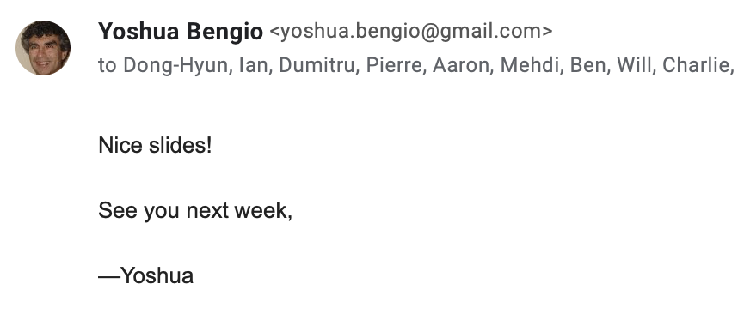
We count the words…
obtaining X

Slide 32
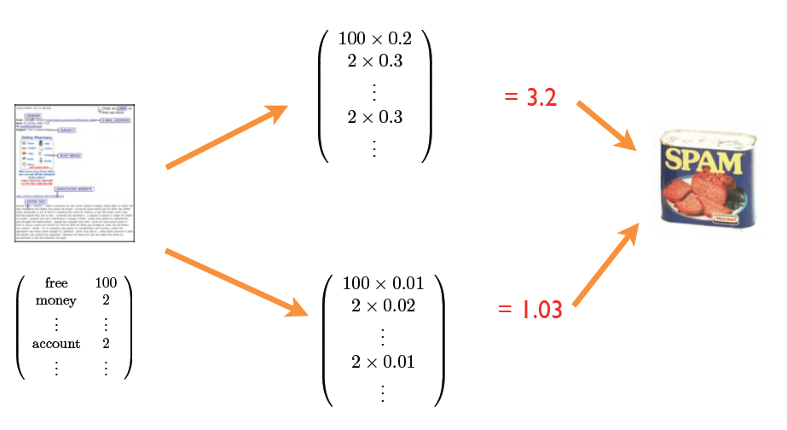
The spam detection algorithm
Confidence / performance guarantee?
Why linear combination?
Why these words?
Where do the weights come from?

Slide 33
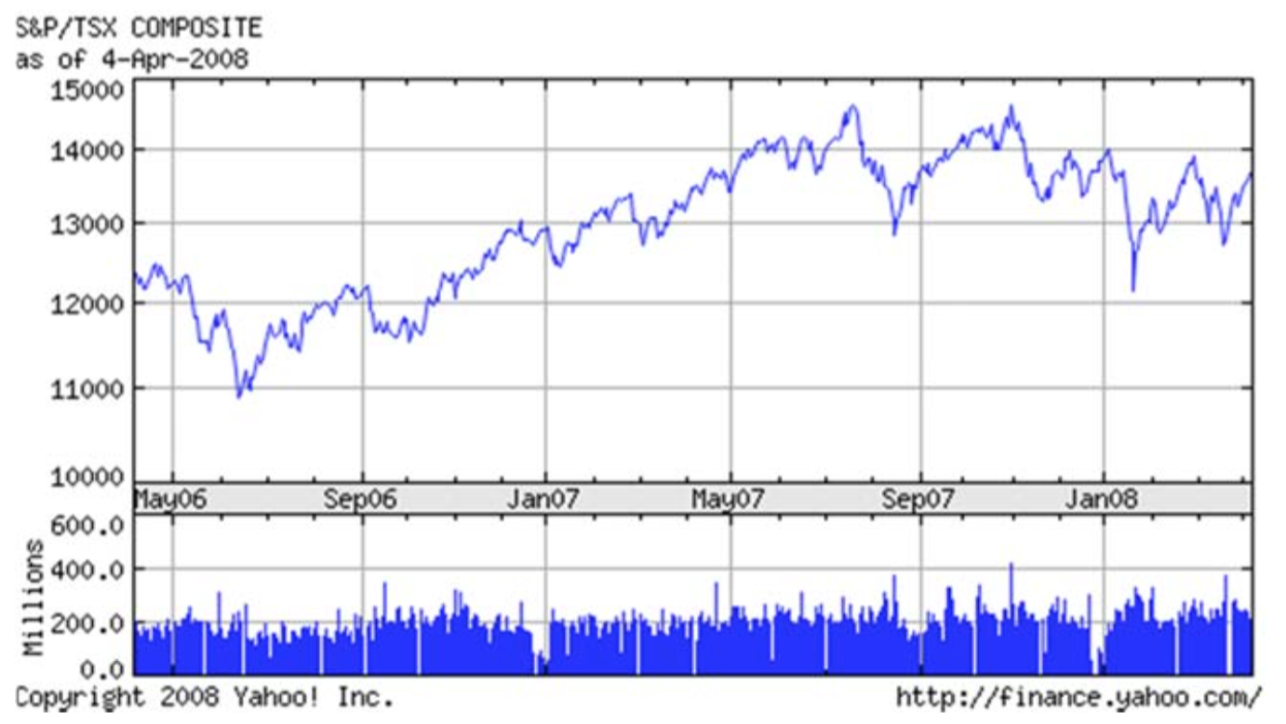
Supervised learning
Example 5: predicting stock prices on the market
The goal is to predict the price at a future date, for example in a few days
This is a regression task, since the output is continuous

Slide 34
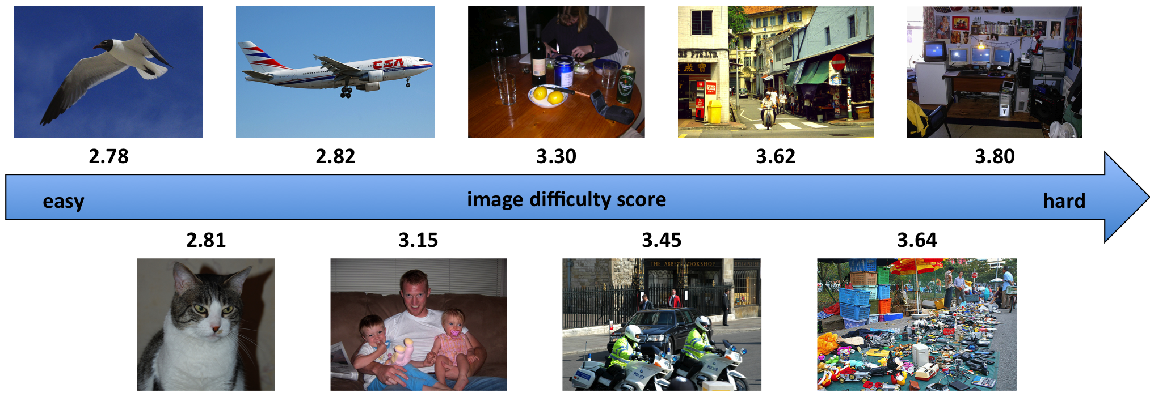
Supervised learning
Example 6: image difficulty prediction [Ionescu et al. CVPR2016]
The goal is to predict the time necessary for a human to solve a visual search task (data set available for projects!)
This is a regression task, since the output is continuous

Slide 35
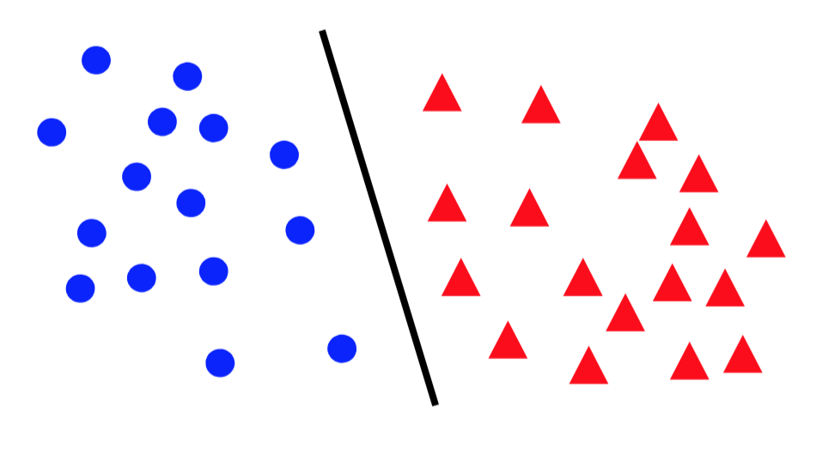
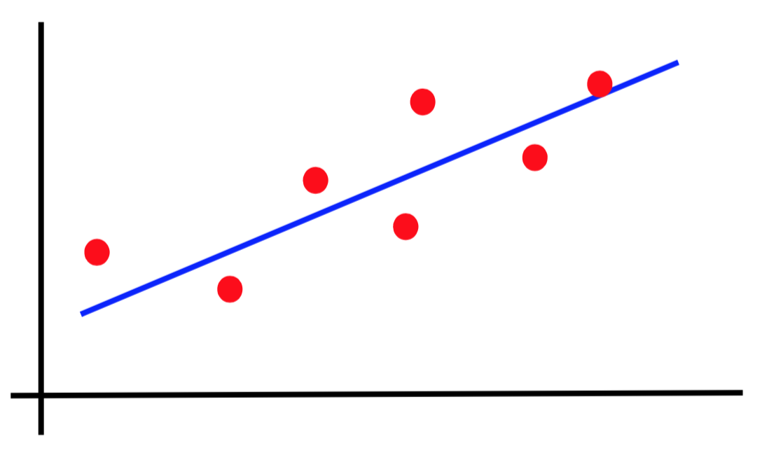
Canonical forms of supervised learning problems
Classification
Regression

Slide 36

Age estimation in images
Classification?
Regression?
What age?

Slide 37
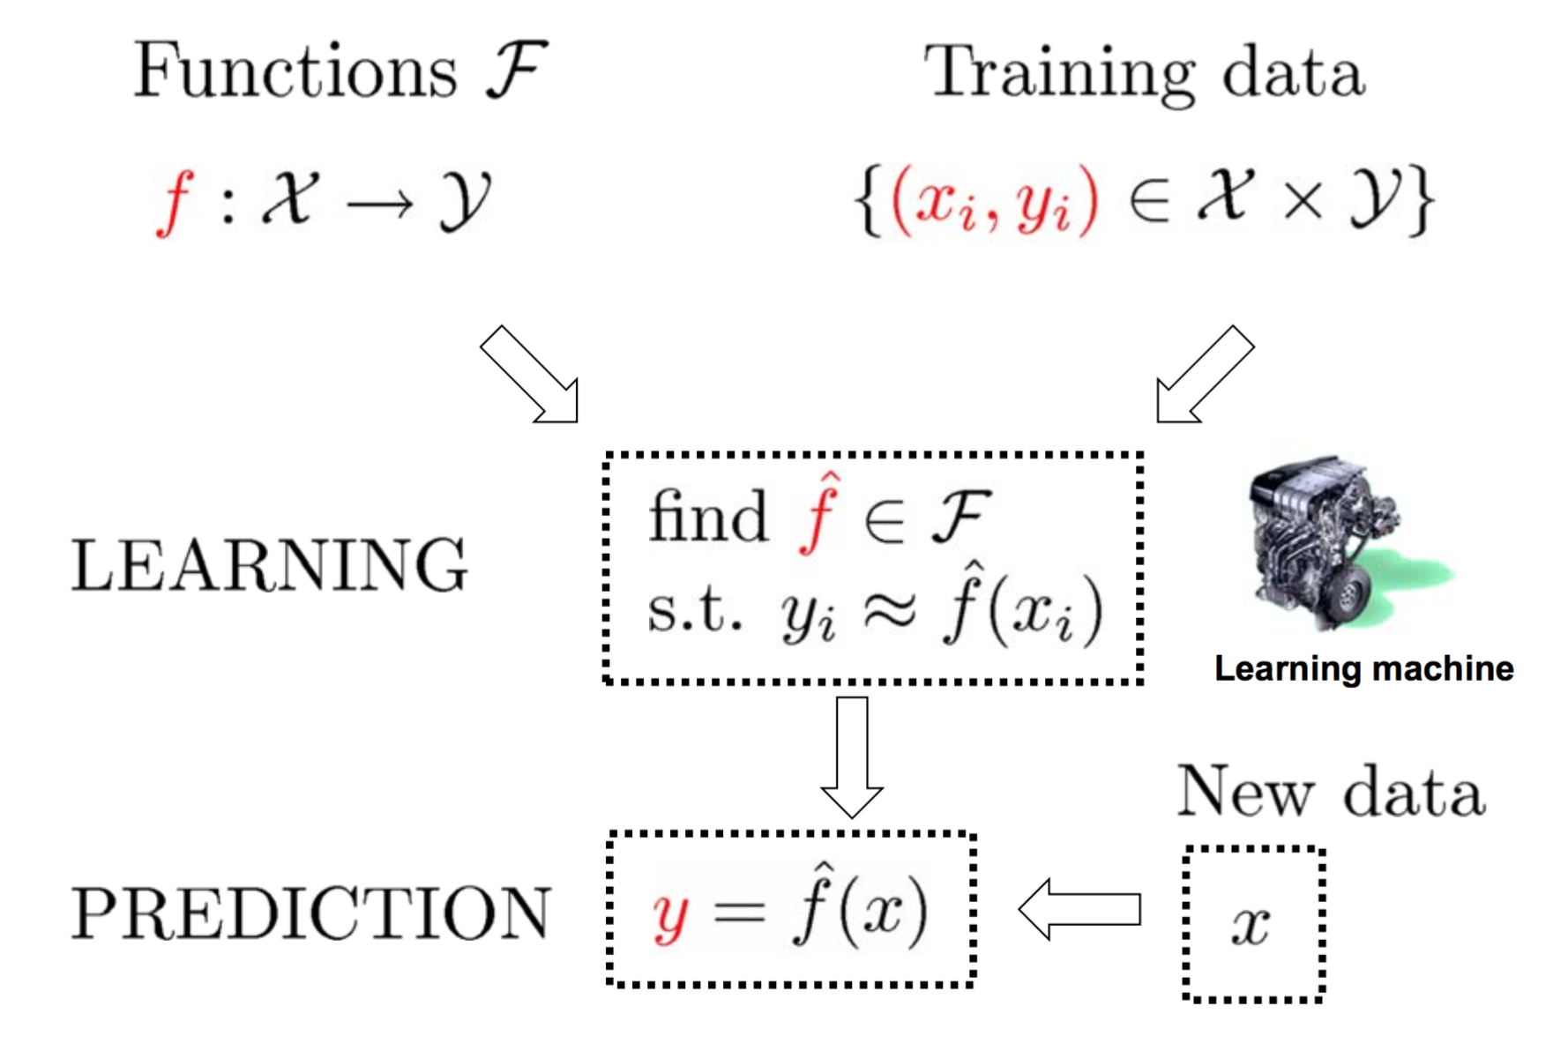
The supervised learning paradigm

Slide 38
Supervised learning models
Naive Bayes (lecture 2)
K-Nearest Neighbors (lecture 3)
Support Vector Machines (lecture 4, 5)
Kernel methods (lecture 4)
Kernel Ridge Regression (lecture 4)
Neural networks (lectures 5, 6, 7)
Decision trees and random forests (lecture 8)
Many others…

Slide 39
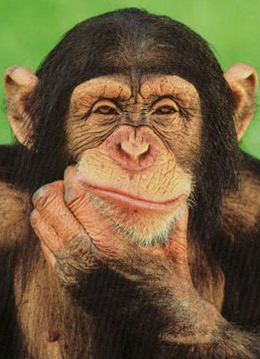
Unsupervised learning
We have an unlabeled training set of samples
Example 1: clustering images based on similarity

Slide 40
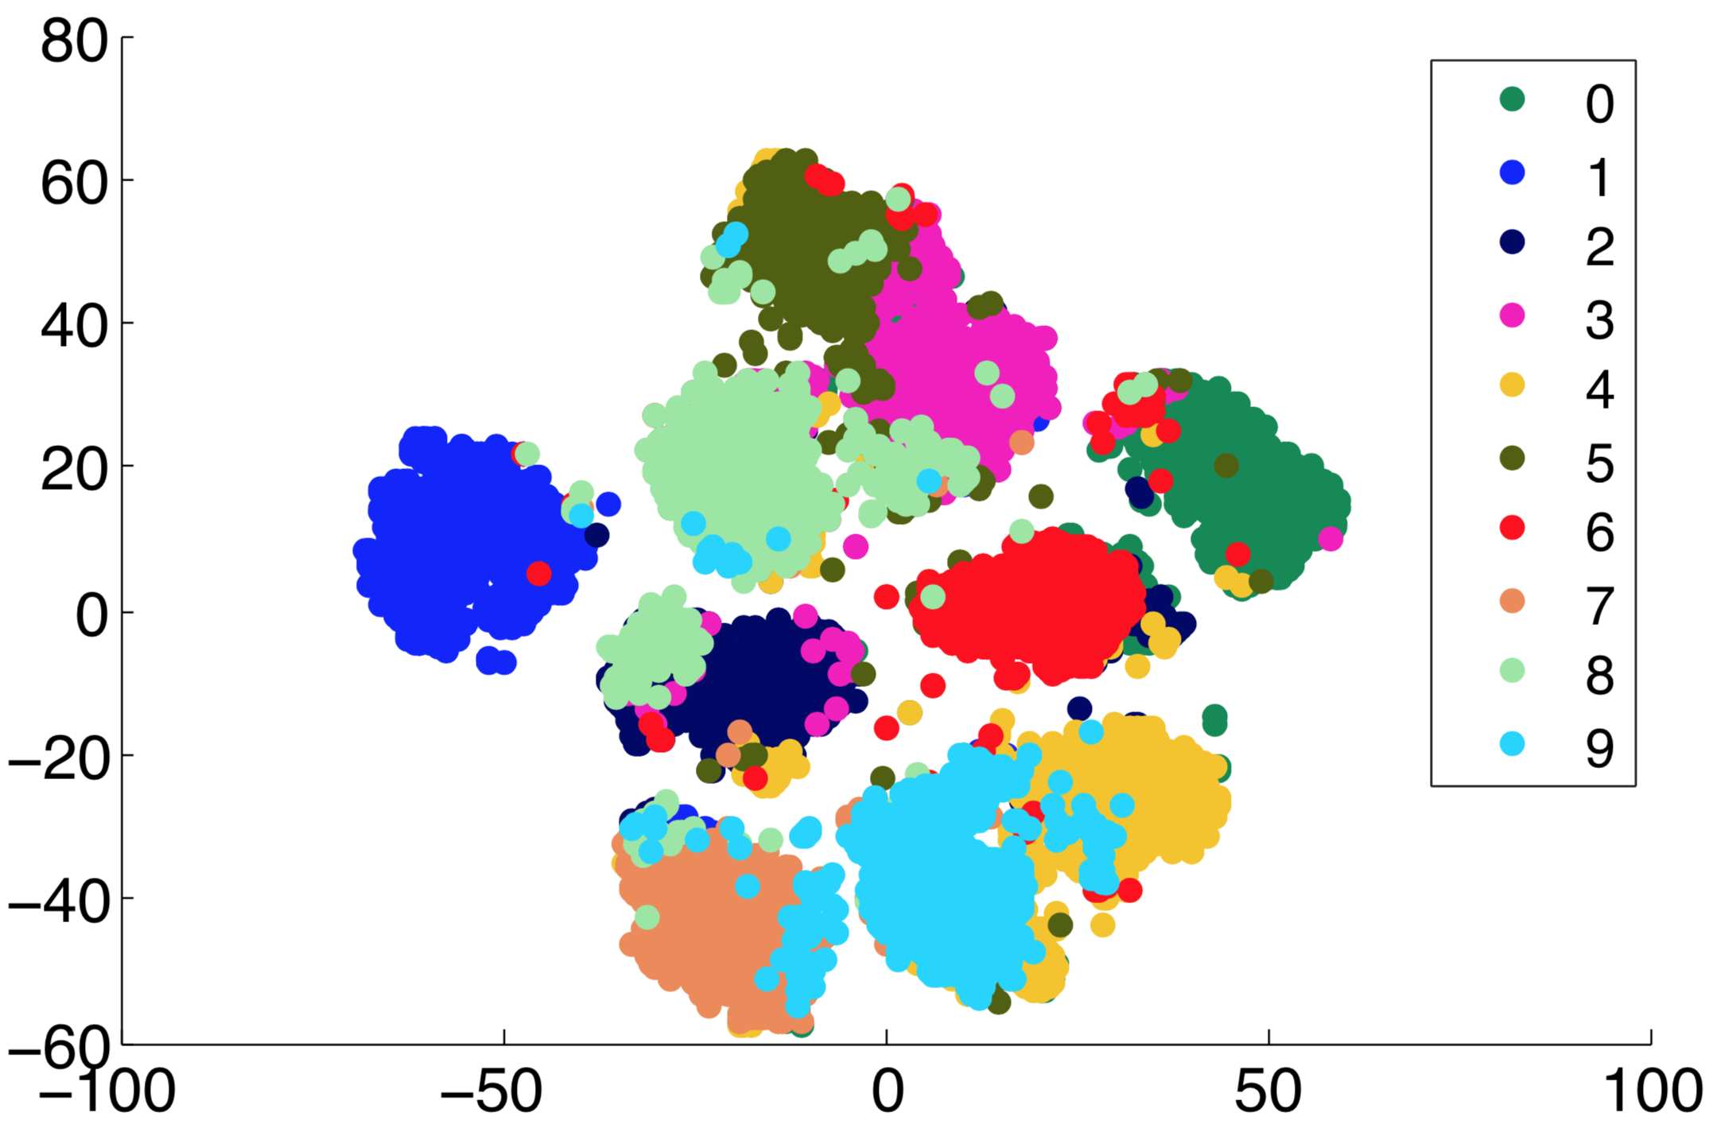
Unsupervised learning
Example 1: clustering MNIST images based on similarity [Georgescu et al. ICIP2019]

Slide 41
Unsupervised learning
Example 2: unsupervised features learning

Slide 42
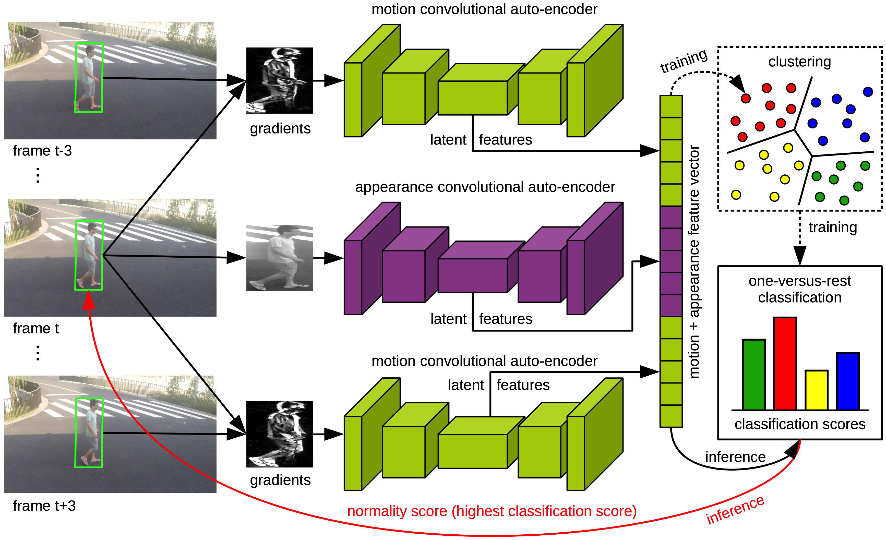
Unsupervised learning
Example 2: unsupervised features learning for abnormal event detection [Ionescu et al. CVPR2019]

Slide 43
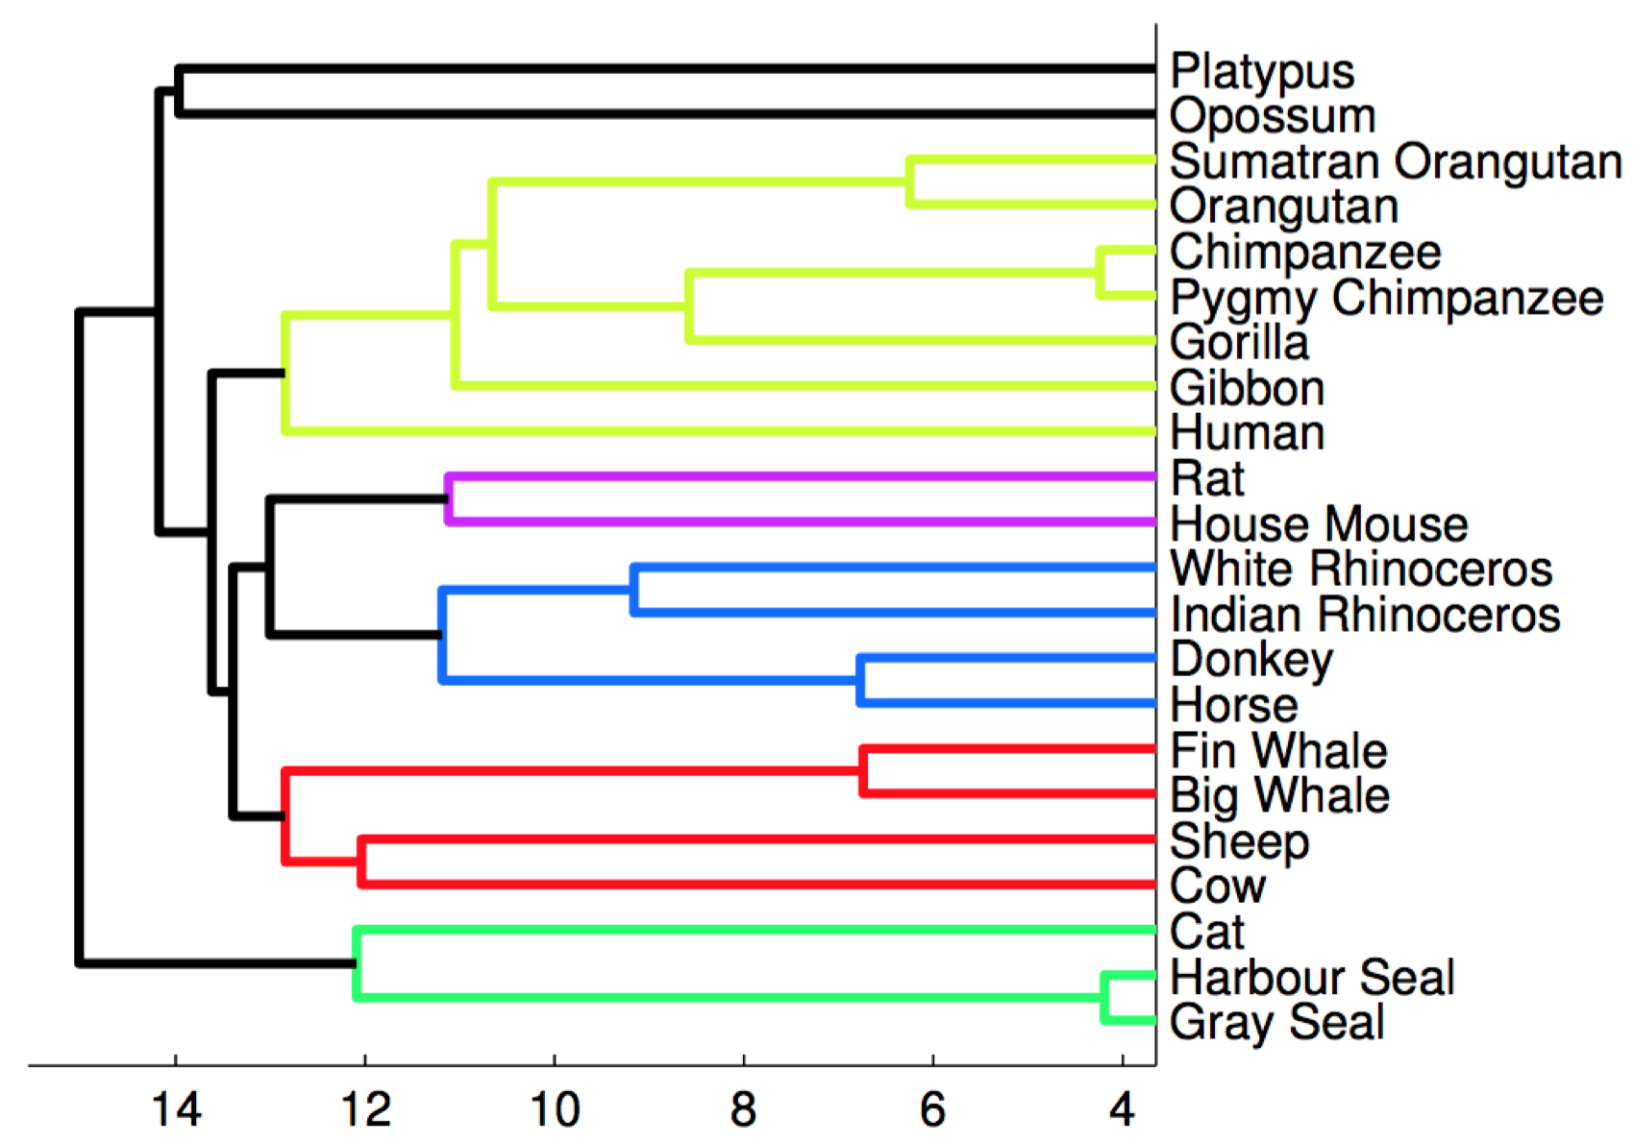
Unsupervised learning
Example 3: clustering mammals by family, species, etc.
The task is to generate the phylogenetic tree based on DNA

Slide 44
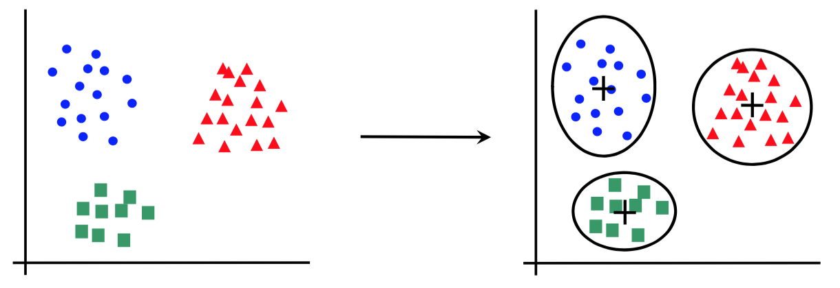
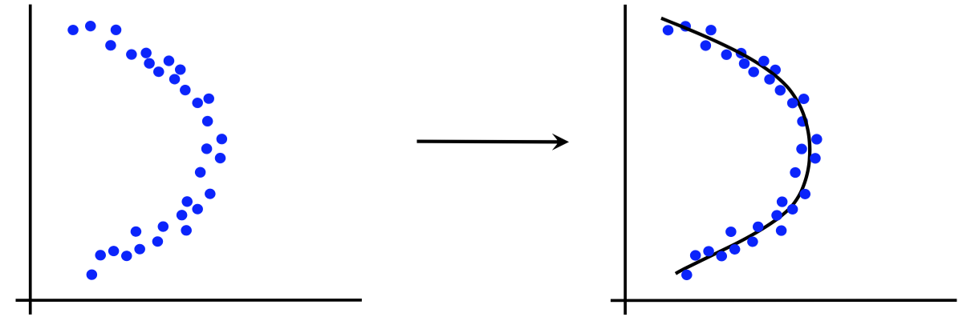
Canonical forms of unsupervised learning problems
Clustering
Dimensionality Reduction

Slide 45
Unsupervised learning models
K-means clustering (lecture 9)
DBScan (lecture 9)
Hierarchical clustering (lecture 10)
Principal Component Analysis (lecture 11)
Hidden Markov Models (lecture 12)

Slide 46
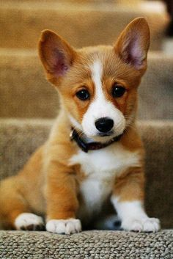
Semi-supervised learning
We have a training set of samples that partially annotated with class labels
Example 1: object recognition in images, some of which are annotated with corresponding class labels
Car
Dog
Person

Slide 47
Reinforcement learning
How does it work?
The system learns to intelligent behavior using a reinforcement signal (reward)
The reward is given after several actions are taken (it does come after every action)
Time matters (data is sequential, not i.i.d.)
The actions of the system can influence the data

Slide 48
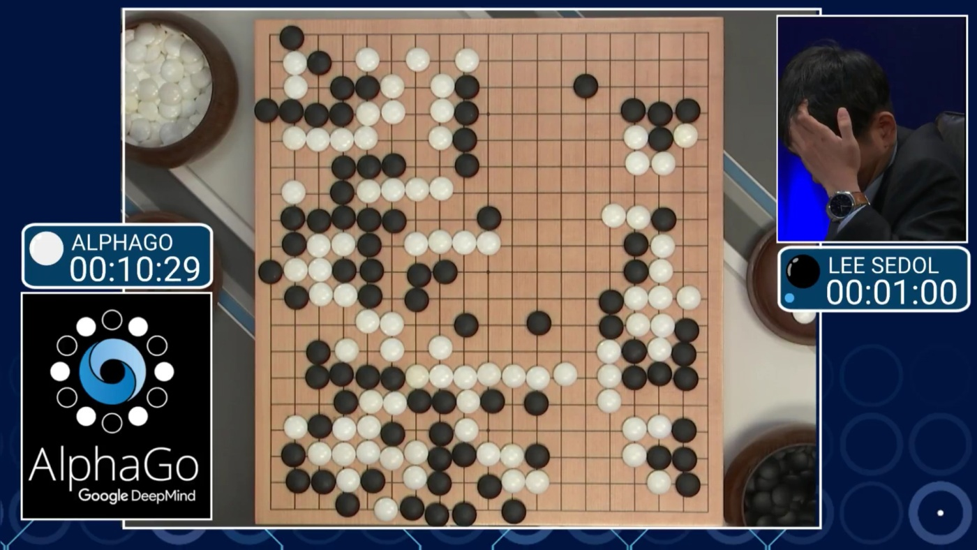
Reinforcement learning
Example 1: learning to play Go
+/- reward for winning / losing the game

Slide 49
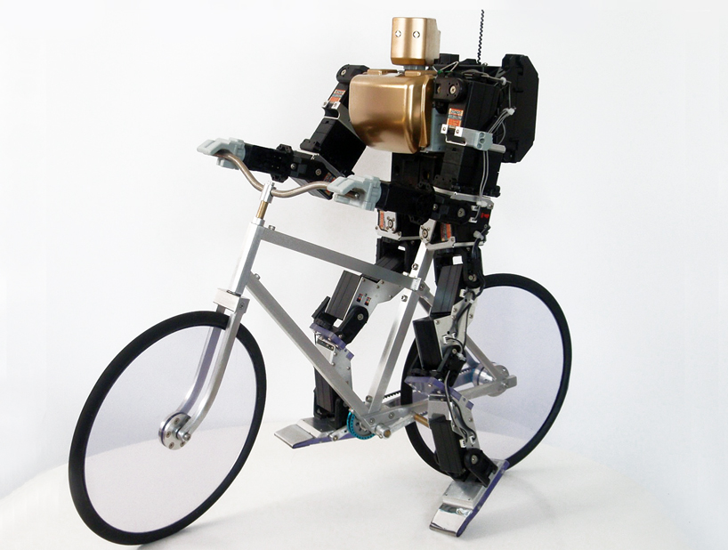
Reinforcement learning
Example 2: teaching a robot to ride a bike
+/- reward for moving forward / falling

Slide 50
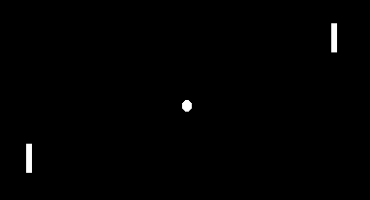
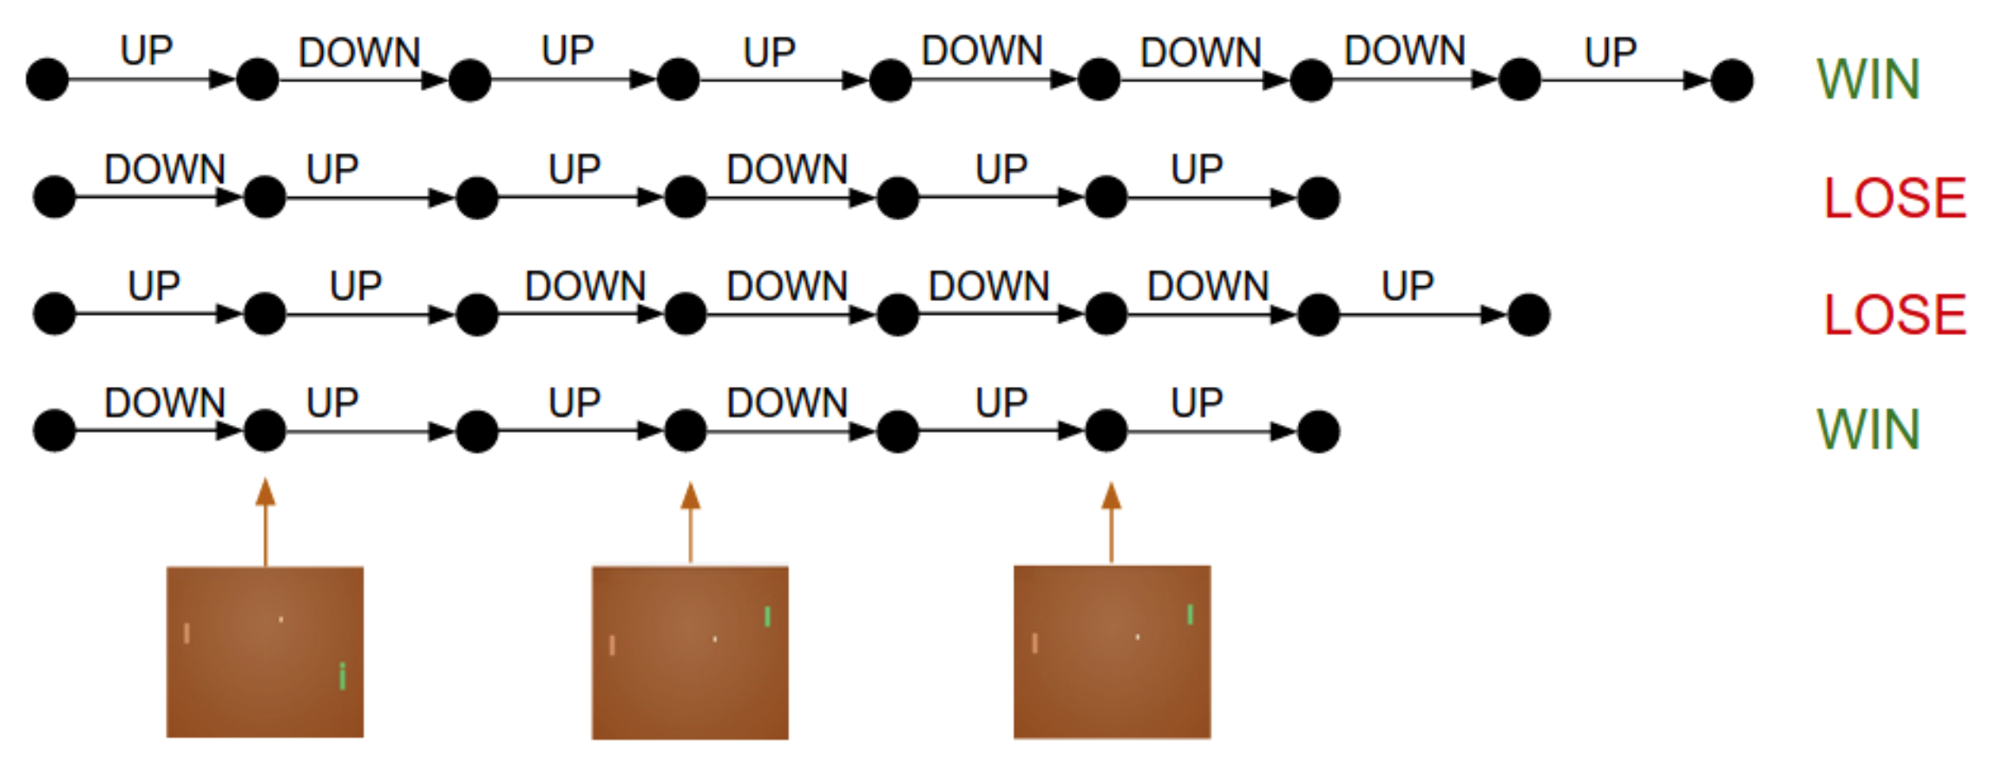
Reinforcement learning
Example 3: learning to play Pong from image pixels
+/- reward for increasing
personal / adversary score

Slide 51
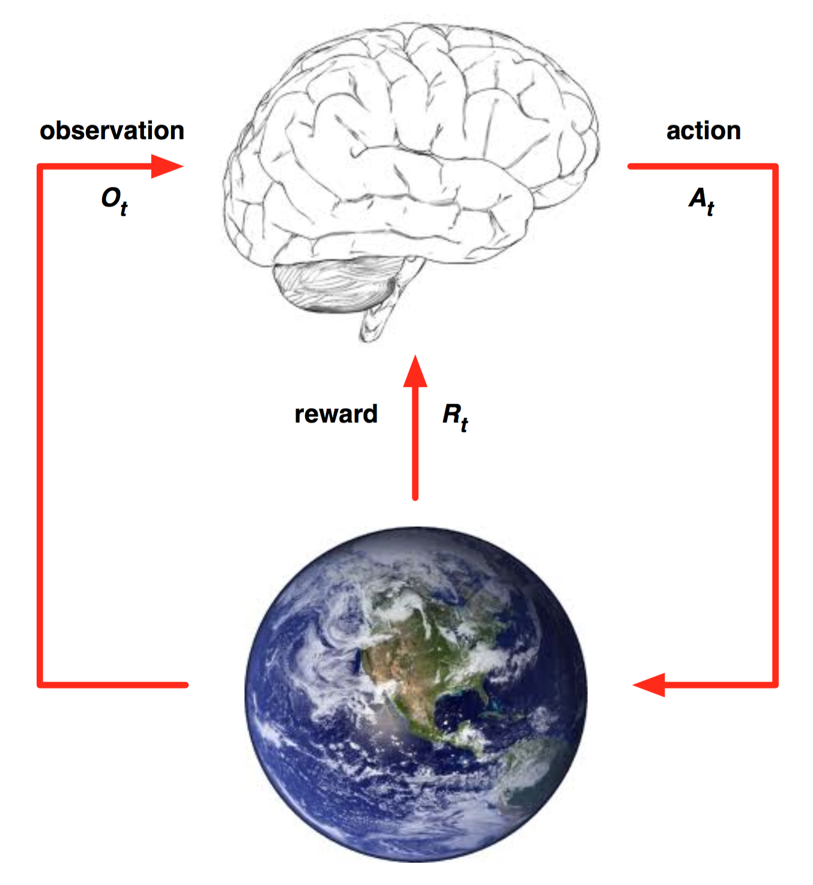
Reinforcement learning paradigm

Slide 52
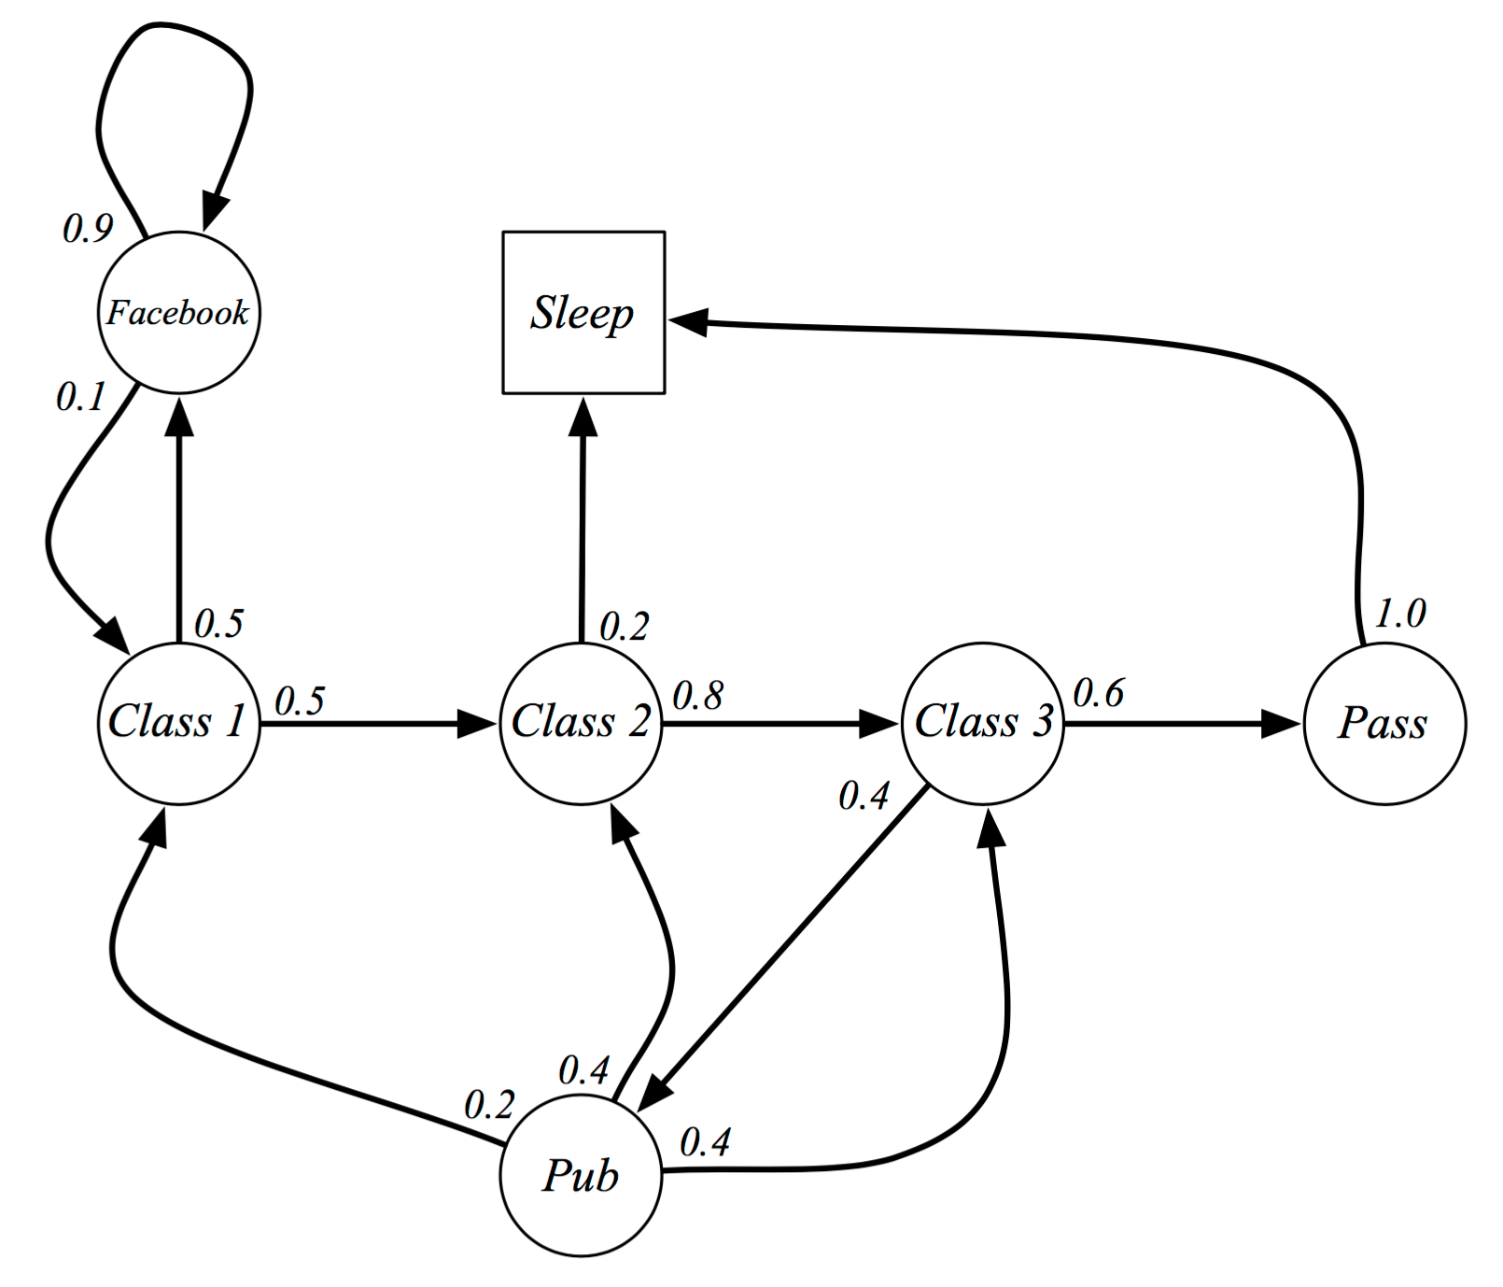
Formalizing as Markov Decision Process

Slide 53
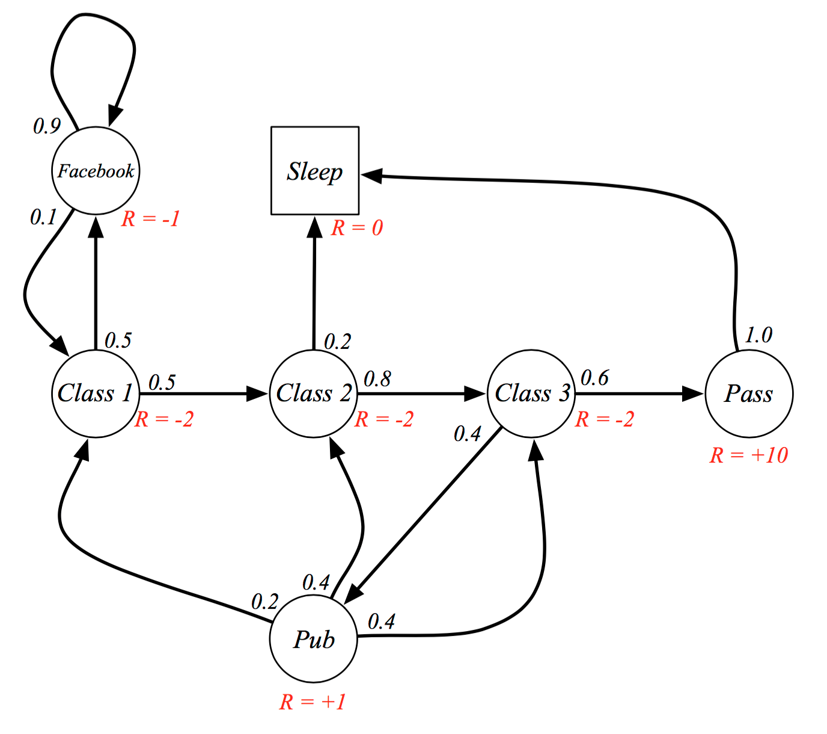
Formalizing as Markov Decision Process

Slide 54
Formalizing as Markov Decision Process
Solution based on dynamic programming (small graphs) or approximation (large graphs)
Goal: select the actions that maximize the total final reward
The actions can have long-term consequences
Sacrificing the immediate reward can lead to higher rewards on the long term

Slide 55
Formalizing as Markov Decision Process
AlphaGo example:
Narrator 1: “That’s a very strange move”
Narrator 2: “I thought it was a mistake”
But actually, “the move turned the course of the game. AlphaGo went on to win Game Two, and at the post-game press conference, Lee Sedol was in shock.”
https://www.wired.com/2016/03/two-moves-alphago-lee-sedol-redefined-future/

Slide 56
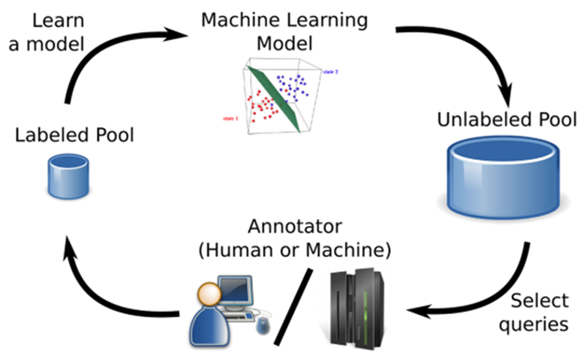
Active learning
Given a large set of unlabeled samples, we have to choose a small subset for annotation in order to obtain a good classification model

Slide 57

Transfer learning
Starting with a model trained for a certain task / domain, use the model for a different task / domain
More specific object classes,
face recognition,
texture classification, etc.

Slide 58
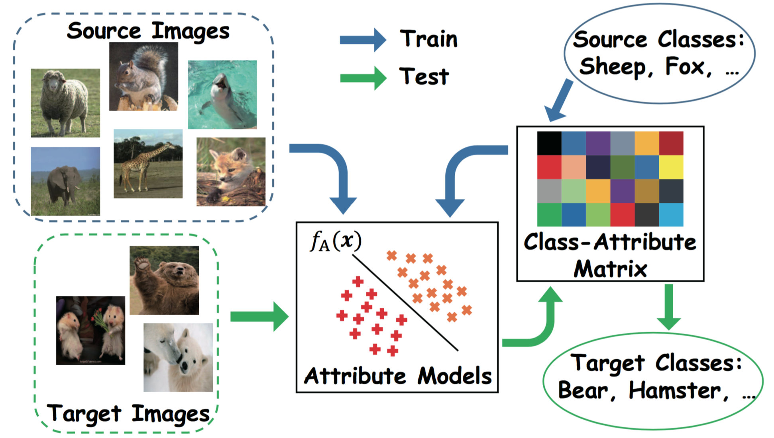
Transfer learning
Example 2: zero-shot learning

Slide 59
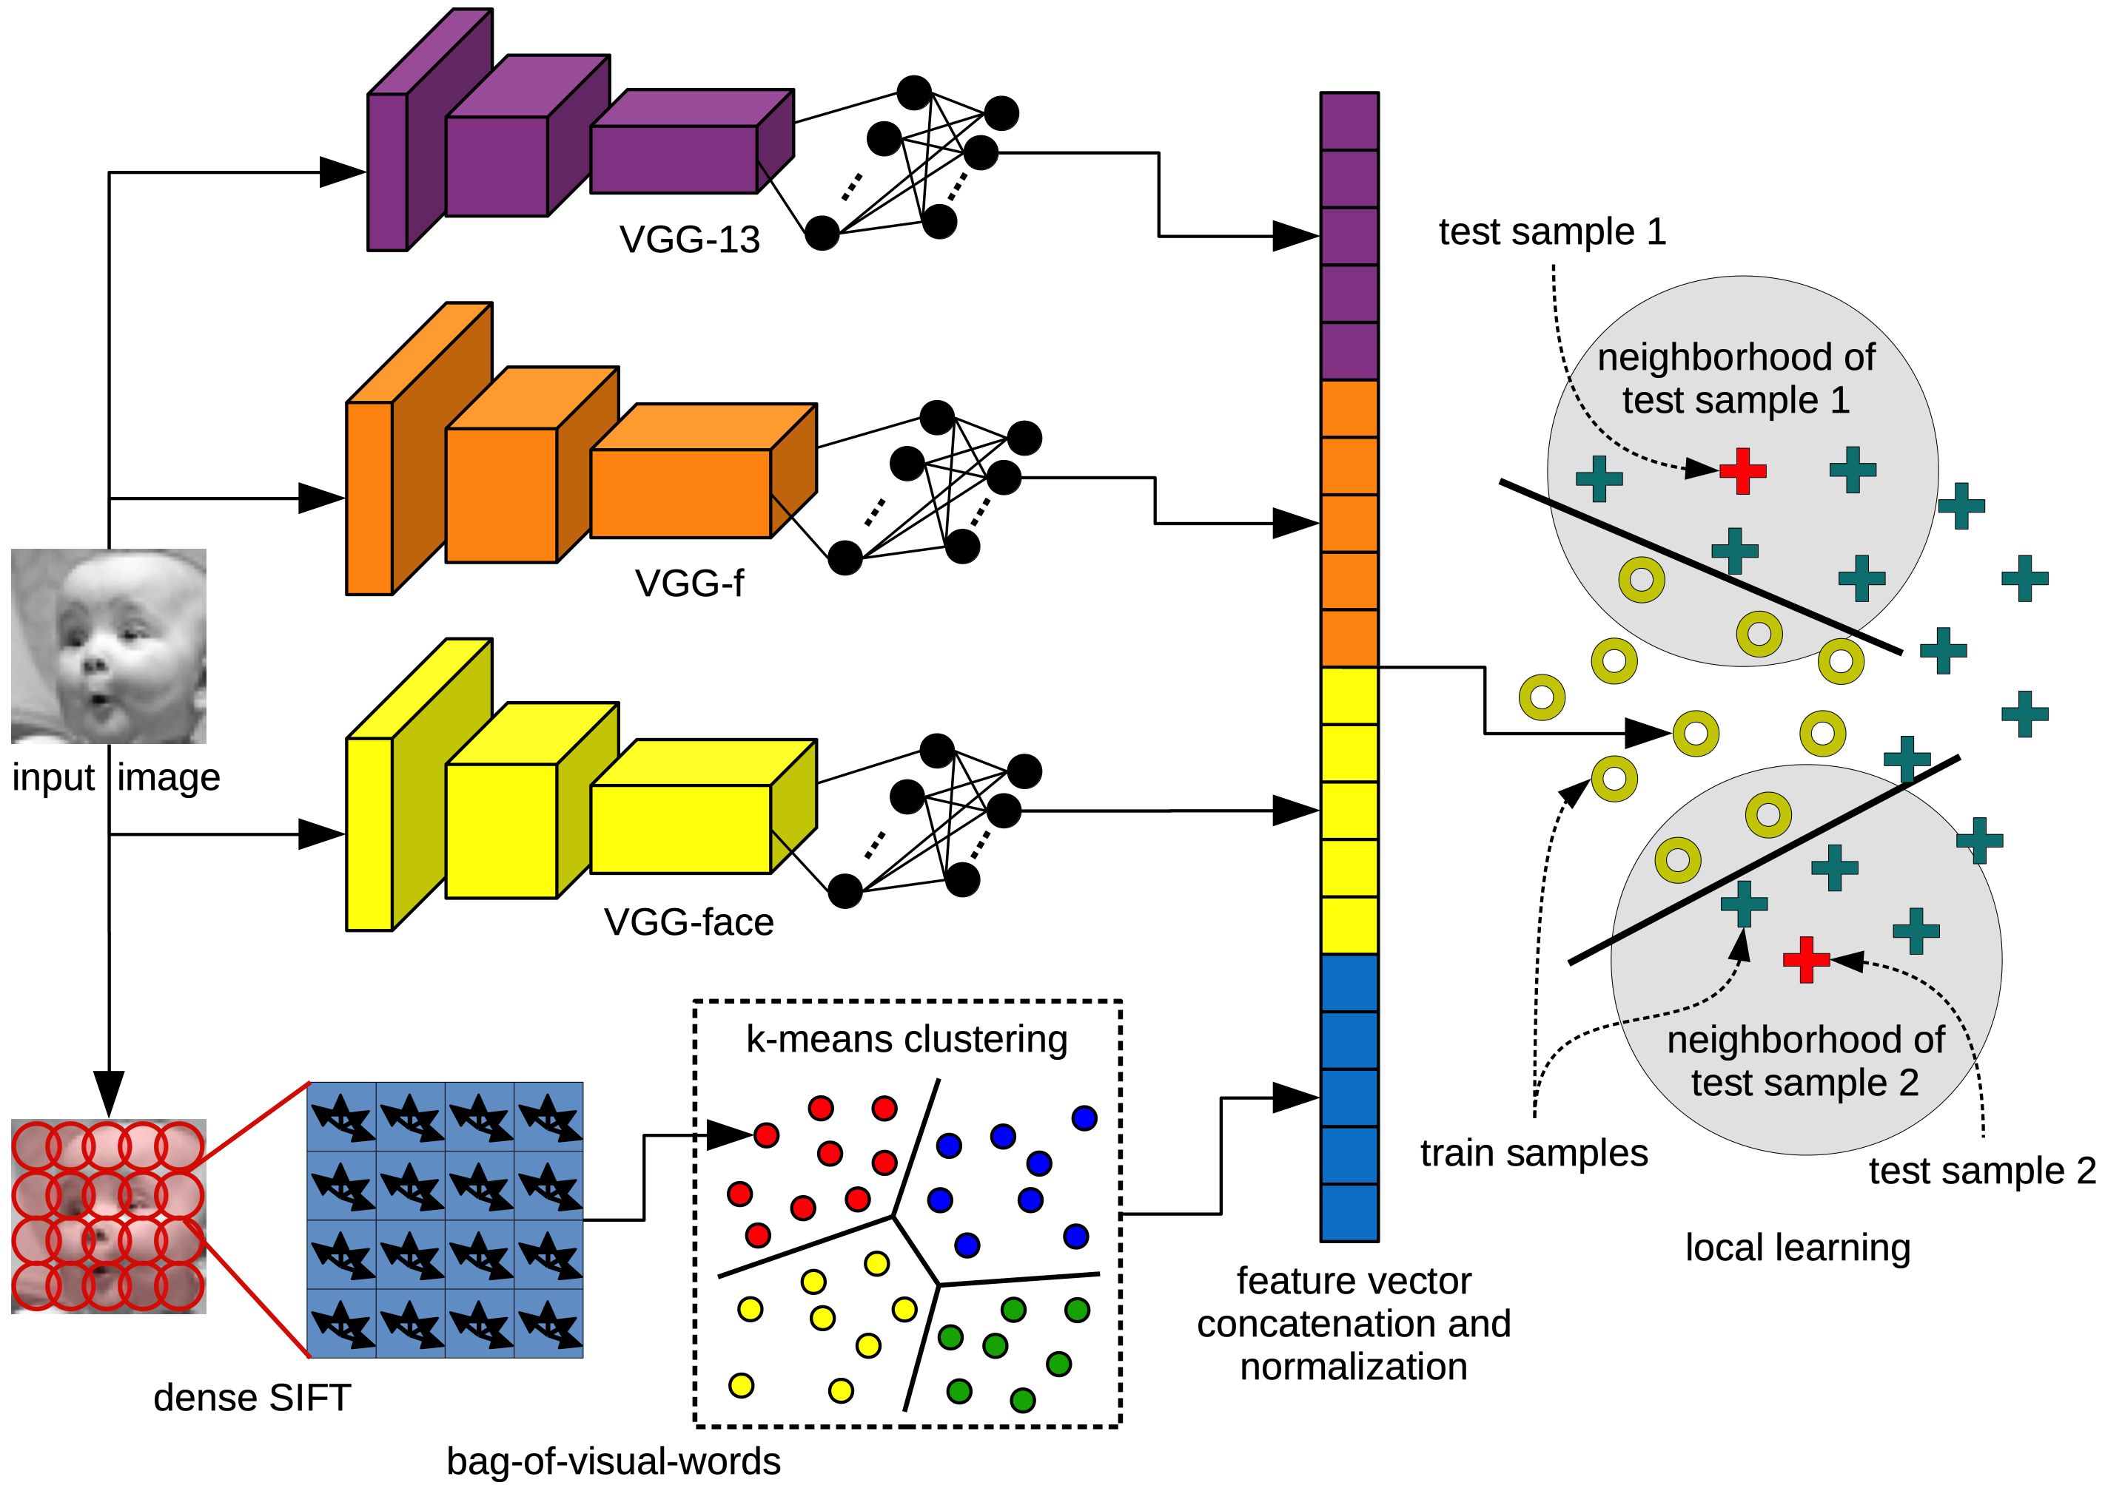
Transfer learning
Adapt the model to specific test samples
Example 1: facial expression recognition [Georgescu et al. Access2019]

Slide 60
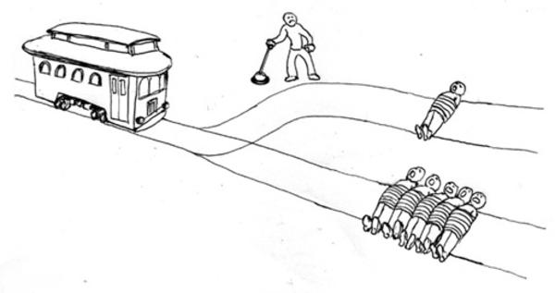
Many interesting applications, but…
What is ethical or not?
Trolley paradox

Slide 61
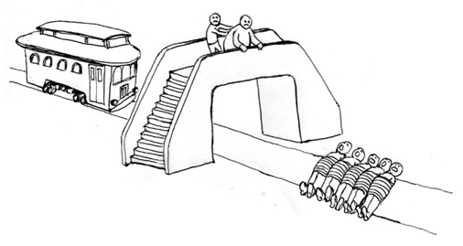
Many interesting applications, but…
What is ethical or not?
Trolley paradox

Slide 62
Many interesting applications, but…
What is ethical or not?
Trolley paradox
http://moralmachine.mit.edu

Slide 63
Bibliography

Slide 64
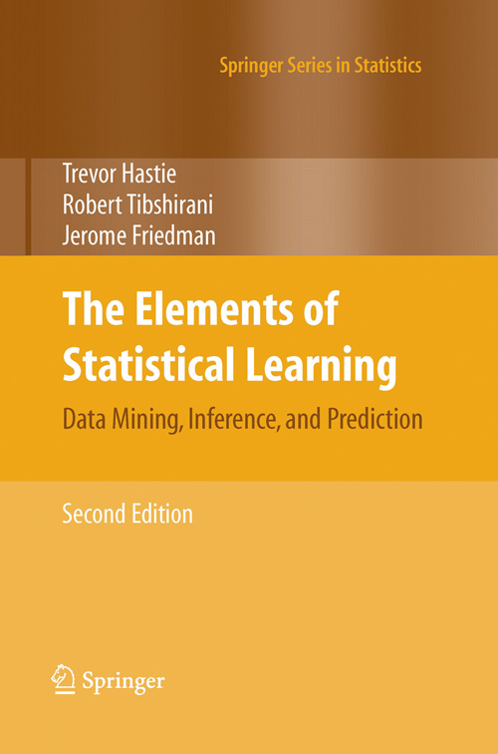

Slide 65
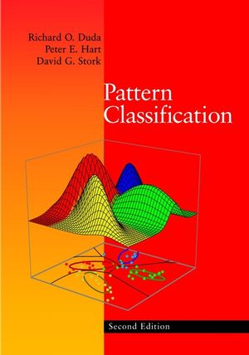

Slide 66
